Slide 1

School of Basic and Applied Sciences
Course Code: BBS01T1002 Course Name: Semiconductor Physics
Quantum Free Electron Theory and Fermi Dirac Distribution function-I
Outlines:
Classical free electron theory and its draw back
Quantum Free Electron Theory
Wavefunction and its characteristics
Faculty Name: Dr Susmita Majumdar Program Name: B. Tech.

Slide 2
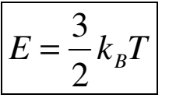
Prerequisite/Recapitulations
Classical free electron theory and its draw back
Classical Model:
The valence electrons in a solid are free to move anywhere in the metal in a way similar to gas molecules in a container. Therefore, the assembly of free electrons in a metal is called electron gas.
The electrical and thermal conductivities of the metals is solely due to free electrons
The electrons move randomly in all directions with random velocities following the classical Maxwell Boltzmann distribution. The average kinetic energy of a free electron is thus given by
Unlike gas molecules, the free electrons move in a background of immobile positive ions.
The free electrons make collisions from time to time with fixed positive ions. Between these collisions, the electron-ion interaction is neglected. This is called free electron approximation. Further electron-electron interaction is also neglected. This is called independent electron approximation

Slide 3
Prerequisite/Recapitulations
Classical free electron theory and its draw back
Classical Model:
Collisions in Drude model, as in kinetic theory, are instantaneous events that abruptly alter the velocity of an electron.
An electron experiences a collision with a probability per unit time 1/τ. This means that on the average an electron travels for time τ after it undergoes a collision and before its next collision i.e. the average time between two successive collisions is τ .This time is known as relaxation time (τ). The average distance traversed by a free electron between two successive collision s with positive ions is called the mean free path (λ).
In absence of external electric field, the random motion of free electrons is equally probable in all directions. As a result, there is no net current in the absence of electric field. When an external electric field is applied, the electrons are accelerated in a direction opposite to that of electric field. Hence they acquire an average velocity in a direction opposite to that of electric field which is superimposed over the random motion. This velocity is known as the drift velocity (v_{d}).

Slide 4
Prerequisite/Recapitulations
Drawbacks of classical free electron theory
From the classical free electron theory the value of specific heat of metals is given by 4.5R, where ‘R’ is called the universal gas constant. But the experimental value of specific heat is nearly equal to 3R.
With help of this model we can’t explain the electrical conductivity of semiconductors or insulators.
The theoretical value of paramagnetic susceptibility is greater than the experimental value.
Ferromagnetism cannot be explained by this theory.
At low temperature, the electrical conductivity and the thermal conductivity vary in different ways. Therefore K/σT is not a constant. But in classical free electron theory, it is a constant in all temperature.
The photoelectric effect, Compton effect and the black body radiation cannot be explained by the classical free electron theory.

Slide 5
Objectives
After the completion of this lecture you will be able to:
Understand the quantum free electron theory
Explain the Wavefunction and its characteristics
Solve the problems based on wavefunction

Slide 6
Introduction
Basic assumptions of Quantum free-electron theory
The energy values of electrons are quantized as various allowed energy levels.
The distribution of electrons in these allowed levels takes place according to Pauli exclusion principle
The electrons are treated as fermions and obeys Fermi-Dirac statistics
The potential due to lattice ions is taken to be constant throughout the metal.
The attractive force between core and the electron and the repulsion between the electron and electron is ignored.
The metal contains a large number of conduction electrons which are completely free yet are bound to the metal as a whole. Thus a metal is said to be consisting of electron gas.
Free electrons in a metal can be described as free particles confined in a box of certain volume. The possible electronics states and the distribution of electrons in these states can thus be determined using quantum mechanics.

Slide 7
Idea of wave function for quantum particle
Instead of two sets of physical principles in physics, one for the macroworld and one for the microworld, there is only the single set included in quantum mechanics.
The wavefunction attempts to describe a quantum mechanical entity (photon, electron, x-ray, etc.) through its spatial location and time dependence, i.e. the wavefunction is in the most general sense dependent on time and space:
Ψ = Ψ(x; t)
The state of a quantum mechanical system is completely specified by the
wavefunction Ψ(x; t).

Slide 8

Idea of wave function for quantum particle
The Probability that a particle will be found at time t₀ in a spatial interval of width dx centered about x₀ is determined by the wavefunction
as: P(x₀; t₀) dx = Ψ∗(x₀; t₀)Ψ(x₀; t₀)dx = |Ψ(x₀; t₀)|²dx
Since the postulate of the probability is defined through the use of a complex conjugate, Ψ *, it is accepted that the wavefunction is a complex valued entity : Ψ =A + iB
the probability of finding the particle between x1 and x2 is
where A and B are real functions. The complex conjugate Ψ * of Ψ is
Complex conjugate Ψ * =A - iB and so| Ψ |² = Ψ * Ψ= A² - i²B² = A² + B²
Hence | Ψ |² = Ψ * Ψ is always a positive real quantity, as required.

Slide 9
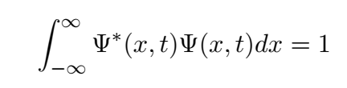
Characteristics for a suitable wavefunction
Characteristics for a suitable wavefunction-(Well-Behaved Wave Functions)
Since the probability of a particle being somewhere in space is unity, the
integration of the wavefunction over all space leads to a probability of 1.
That is, the wavefunction is normalized:
Every acceptable wave function can be normalized by multiplying it by an appropriate constant
In order for Ψ(x; t) to represent a viable physical state, certain conditions are required:
1. The wavefunction must be a single-valued function of the spatial
coordinates. (single probability for being in a given spatial interval)
2. The first derivative of the wavefunction must be continuous so that
the second derivative exists in order to satisfy the Schrodinger equation.
3. The wavefunction cannot have an infinite amplitude over a finite interval. This would preclude normalization over the interval.

Slide 10
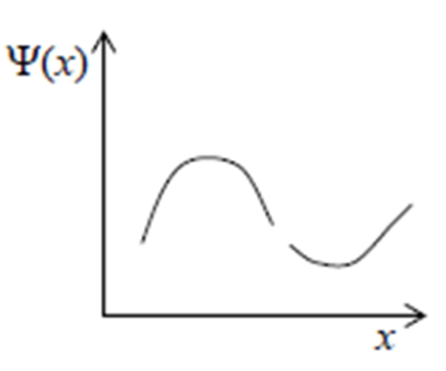
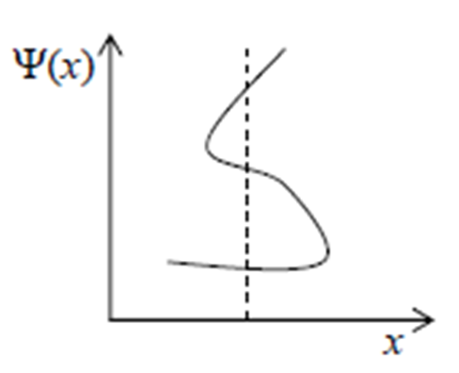
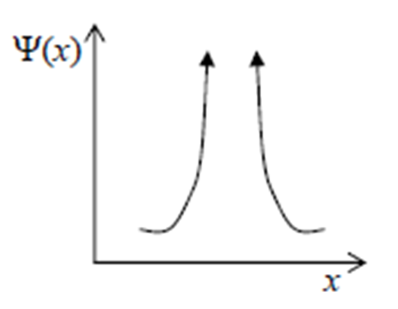
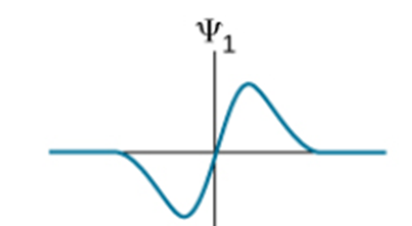
Problems
Problem 1: Acceptable or not acceptable wave function? Why?

Slide 11
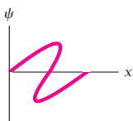
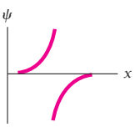
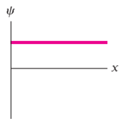
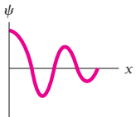
Problems
Problem 2: Acceptable or not acceptable wave function? Why?

Slide 12

Problems
Problem 3: A particle limited to the x axis has the wave function 𝞧 = ax between x = 0 and x =1; 0 elsewhere. (a) Find the probability that the particle can be found between x = 0.45 and x =0.55.
Solution:
The probability of finding the particle between x1 and x2 is
Therefore the probability is -

Slide 13
References
J. Singh , Semiconductor optoelectronics, Physics and Technology, Mc-Graw –Hill Inc.
S.O. Pillai , Solid State Physics, , New Age International (P) Ltd. Sixth edition, 2010.
S.M. Sze, Semiconductor Devices: Physics and Technology, Wiley 2008.
Introduction to Nanotechnology C P Poole, Frank J. Owens, John Wiley & Sons, 2011.
Introduction to Nanoscience and Nanotechnology, KK Chattopadhyay, A N Banerjee, Phi Learning Pvt Ltd., New Delhi, 2012.

